Slide 1
Educating on Phishing A acks: Recognition & Prevention

Slide 2

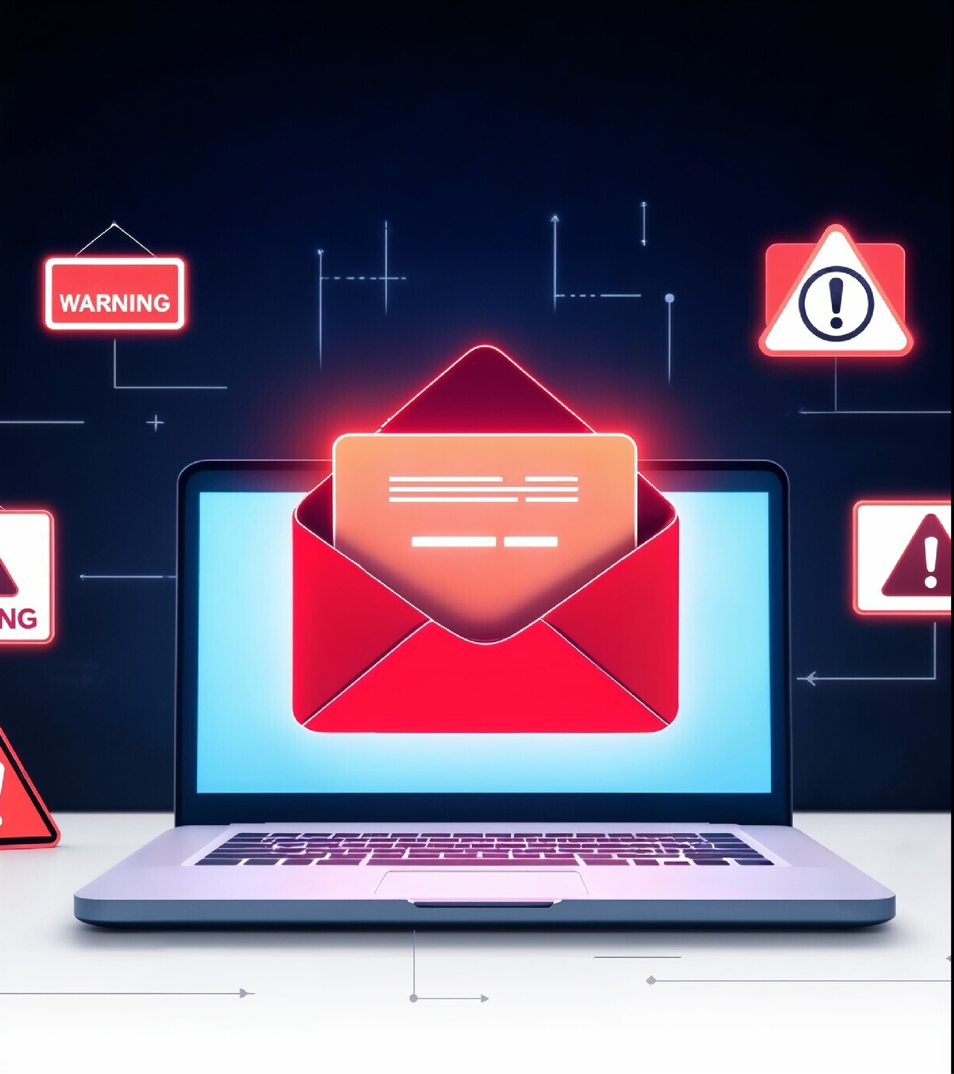
Introduction to Phishing
Phishing is a deceptive practice where attackers impersonate legitimate entities to steal sensitive information. Understanding its mechanisms is crucial for cybersecurity. This presentation will explore strategies to recognize and combat phishing attacks effectively.

Slide 3






Understanding
Phishing
Phishing attacks often come in the form of emails, texts, or websites that appear trustworthy. Attackers use these methods to trick individuals into providing conﬁdential information, leading to potential ﬁnancial loss and identity theft.

Slide 4


Recognizing Phishing Emails
Look for suspicious signs in emails, such as poor grammar, generic greetings, and mismatched URLs. Legitimate organizations typically use personalized communication. Always verify the sender's email address for authenticity.

Slide 5

Identifying Fake Websites
Phishing websites often mimic real ones
but have slight variations in their URLs. Always check for HTTPS in the URL and look for signs of legitimacy, such as contact information and clear branding.

Slide 6


Social Engineering Tactics
Attackers often use social engineering techniques to manipulate individuals into divulging information. Be cautious of unsolicited requests for sensitive data and be aware of the pressure tactics used to create urgency.

Slide 7

Protecting Personal Information
Always safeguard your personal information. Avoid sharing sensitive data through unsecured channels and be wary of sharing too much on social media, as attackers can use this information for phishing attempts.

Slide 8


Using Security
Software
Invest in reliable security software that includes features to detect and block phishing attempts. Regularly update your software to ensure you are protected against the latest threats and vulnerabilities.

Slide 9

Educating Employees
Organizations should conduct regular
training sessions to educate employees about phishing threats. Empowering staff with knowledge can signiﬁcantly reduce the risk of falling victim to these attacks.

Slide 10


Reporting Phishing A tempts
Encourage individuals to report suspected phishing attempts to their IT department or relevant authorities. Prompt reporting can help mitigate risks and prevent further attacks from occurring.

Slide 11

Conclusion and Best Practices
In conclusion, remaining vigilant and informed is key to combating phishing attacks. Adopting best practices such as verifying sources, using security tools, and educating others can signiﬁcantly enhance your cybersecurity posture.

Slide 12

Thanks!
Presented By :
Khushali Tank

